Slide 1


A Technical Seminar Report in partial fulfillment of the degree
Bachelor of Technology
in
Computer Science & Artificial Intelligence
By
K . Aalokhya
Hall ticket . No: 2303A51L31
Under the Guidance of
Minakshmi Mam
Submitted to
SCHOOL OF COMPUTER SCIENCE & ARTIFICIAL INTELLIGENCE
SR UNIVERSITY, ANANTHASAGAR, WARANGAL
November, 2024.

Slide 2

SCHOOL OF COMPUTER SCIENCE & ARTIFICIAL INTELLIGENCE
CERTIFICATE
This is to certify that this technical seminar entitled “Neuromorphic Computing in Healthcare: Real-Time Epilepsy Detection “ is the bonafied work carried out by K.Aalokhya for the partial fulfillment to award the degree BACHELOR OF TECHNOLOGY in COMPUTER SCIENCE & ARTIFICIAL INTELLIGENCE during the academic year 2024-2025 under our guidance and Supervision.
Dr. Guide Name Dr. M.Sheshikala
Designation, Professor&HOD (CSE),
SR University, SR University , Ananthasagar, Ananthasagar, Warangal.
External Examiner

Slide 3
ACKNOWLEDGEMENT
We owe an enormous debt of gratitude to our Technical Seminar guide Dr. Guide Name, Assistant Professor as well as Head of the CSE Department Dr. M.Sheshikala, Professor for guiding us from the beginning through the end of the Minor Project with their intellectual advices and insightful suggestions. We truly value their consistent feedback on our progress, which was always constructive and encouraging and ultimately drove us to the right direction.
We express our thanks to Technical Seminar co-ordinators Dr. P Praveen, Assoc. Prof., and Dr. Mohammed Ali Shaik, Assoc. Prof. for their encouragement and support.
We wish to take this opportunity to express our sincere gratitude and deep sense of respect to our beloved Dean, Dr. Indrajeet Gupta, for his continuous support and guidance to complete this technical seminar in the institute.
Finally, we express our thanks to all the teaching and non-teaching staff of the department for their suggestions and timely support.
K.Aalokhya

Slide 4

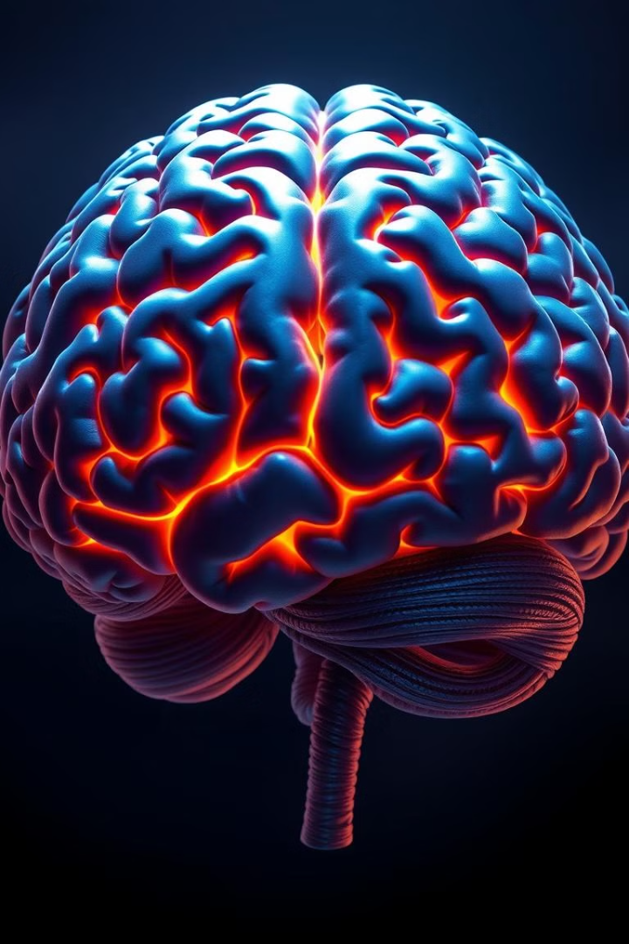
Seminar in Advanced Technologies
Topic:
Neuromorphic Computing in Healthcare: Real-Time Epilepsy Detection
Name : K. AALOKHYA
Batch No.:28
Hall Ticket No.:2303A51L31

Slide 5




Overview of Neuromorphic Computing
Neuromorphic computing is an innovative approach that leverages principles of neuroscience to design computer systems.
Brain-Inspired
1
Mimics the structure and function of the human brain, processing information in a distributed and parallel manner.
Spiking Neurons
2
Utilizes spiking neurons, which communicate through electrical pulses, similar to biological neurons.
Synaptic Plasticity
3
Learns and adapts through synaptic plasticity, enabling continuous improvement and optimization of neural pathways.

Slide 6

Neuromorphic Algorithms and Learning
Spiking Neural Networks
SNNs are a type of artificial neural network designed to process information through spikes, mirroring the behavior of biological neurons.
Reinforcement Learning
They can also employ reinforcement learning techniques, where systems learn through trial and error, receiving rewards for desired actions.
1
2
3
Unsupervised Learning
Neuromorphic systems can leverage unsupervised learning algorithms, which enable them to learn from unlabeled data, mimicking the brain's ability to adapt without explicit instruction.

Slide 7
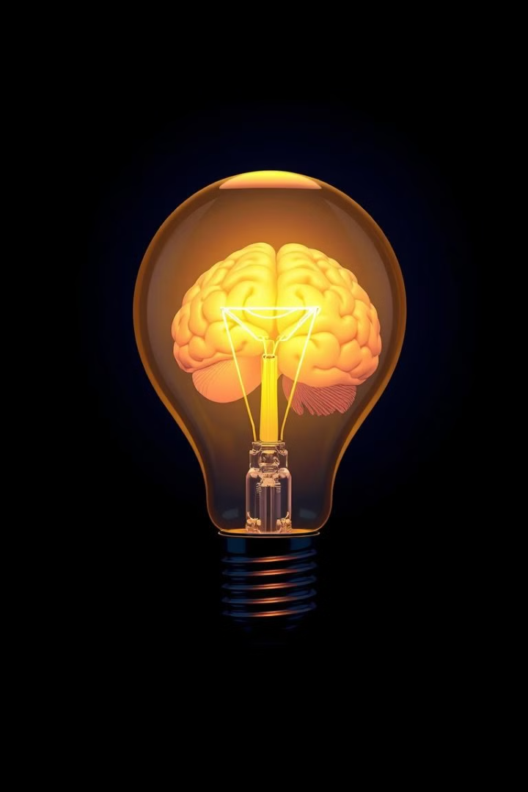
Advantages of Neuromorphic Computing
1000x
Energy Efficiency
Neuromorphic systems can achieve significantly higher energy efficiency than traditional computers, making them ideal for low-power applications.
100x
Parallel Processing
They excel at parallel processing, enabling them to handle complex tasks and massive datasets with remarkable speed.
10x
Adaptive Learning
Neuromorphic systems can adapt and learn in real time, making them particularly well-suited for dynamic and evolving environments.

Slide 8
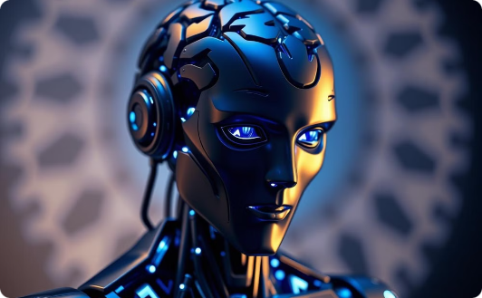
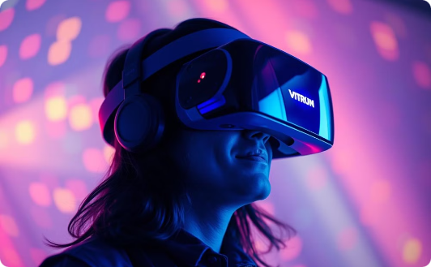
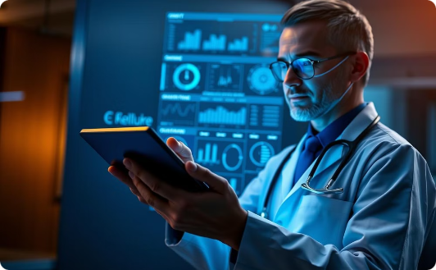
Applications of Neuromorphic Computing
Robotics
AI
Healthcare
Neuromorphic computing can enhance the intelligence and responsiveness of robots.
It can revolutionize artificial intelligence, enabling more powerful and efficient AI systems.
It holds promise for advancements in medical diagnostics, drug discovery, and personalized medicine.

Slide 9
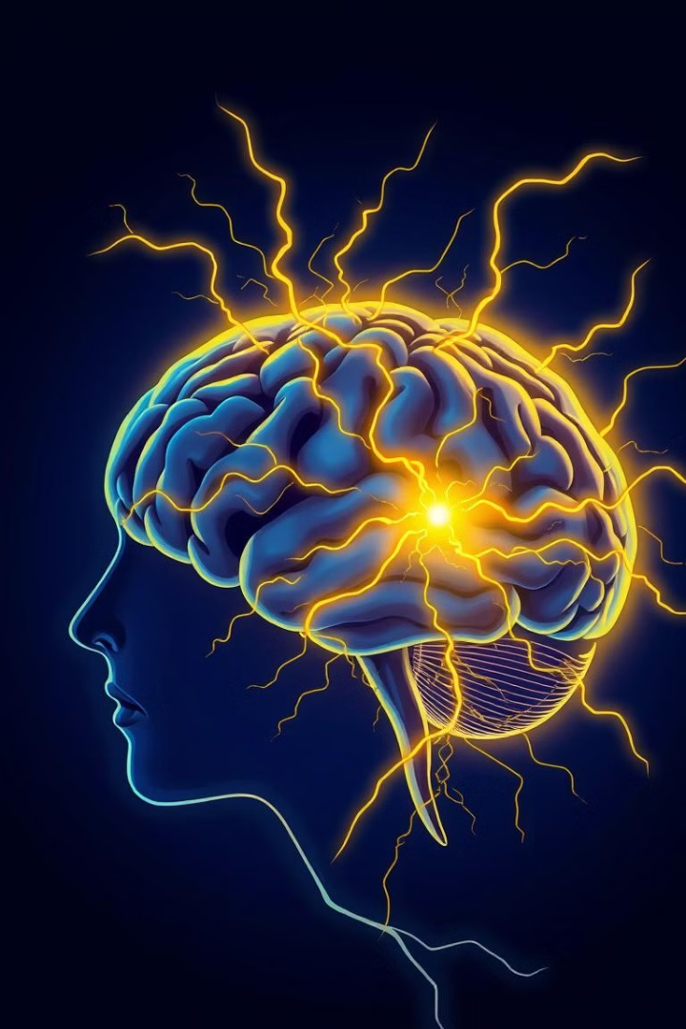
Understanding Epilepsy: A Complex Challenge
Seizures: Unpredictable Events
Diagnosis and Management: A Multifaceted Process
Epilepsy is characterized by recurrent seizures, often unpredictable and disruptive.
Accurate diagnosis and effective seizure management require careful observation, monitoring, and treatment.
Current Approaches: Limitations
Traditional methods for seizure detection and treatment have limitations in accuracy, response time, and patient comfort.

Slide 10
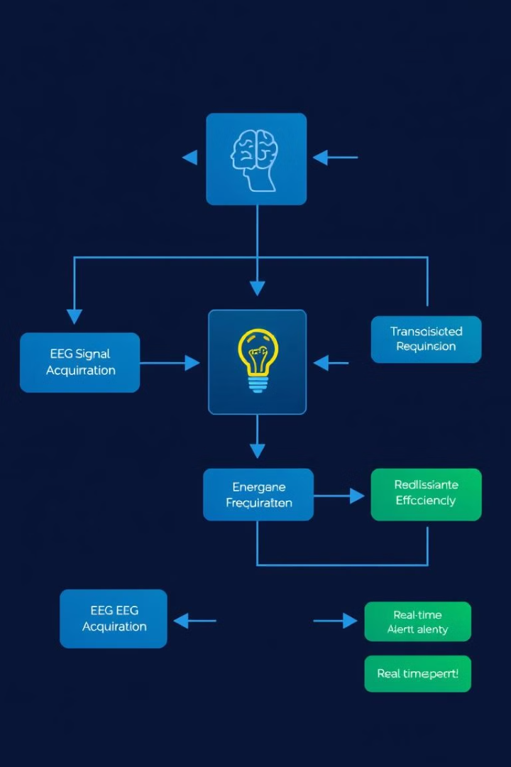



Neuromorphic Computing in Epilepsy Detection: A Promising Solution
Electroencephalogram (EEG)
EEG signals provide real-time information about brain activity.
Neuromorphic Chip Analysis
The chip analyzes EEG signals to detect subtle patterns associated with seizures.
Real-Time Alerts
The chip sends alerts to patients and healthcare providers, enabling timely intervention.

Slide 11
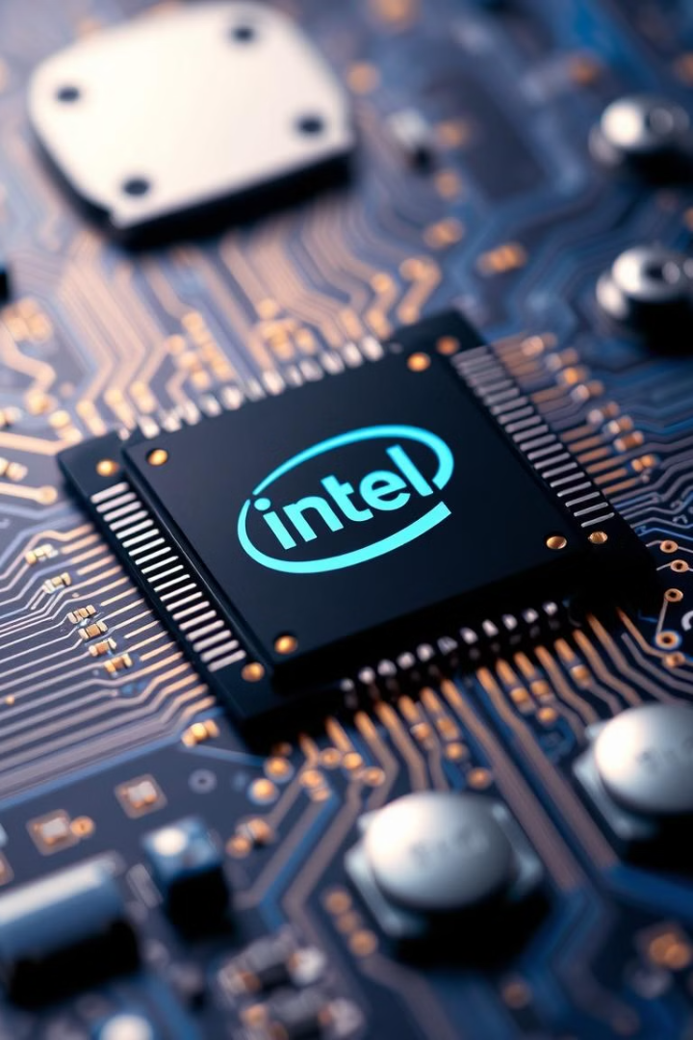



Real-World Example: Intel's Loihi Neuromorphic Chip
Advanced Processing
Loihi is a neuromorphic chip specifically designed for AI applications, including medical diagnostics.
Energy Efficiency
It consumes significantly less power than traditional computers while delivering fast and accurate results.
Real-Time Analysis
Loihi can analyze EEG signals in real time, providing immediate feedback for seizure detection.

Slide 12
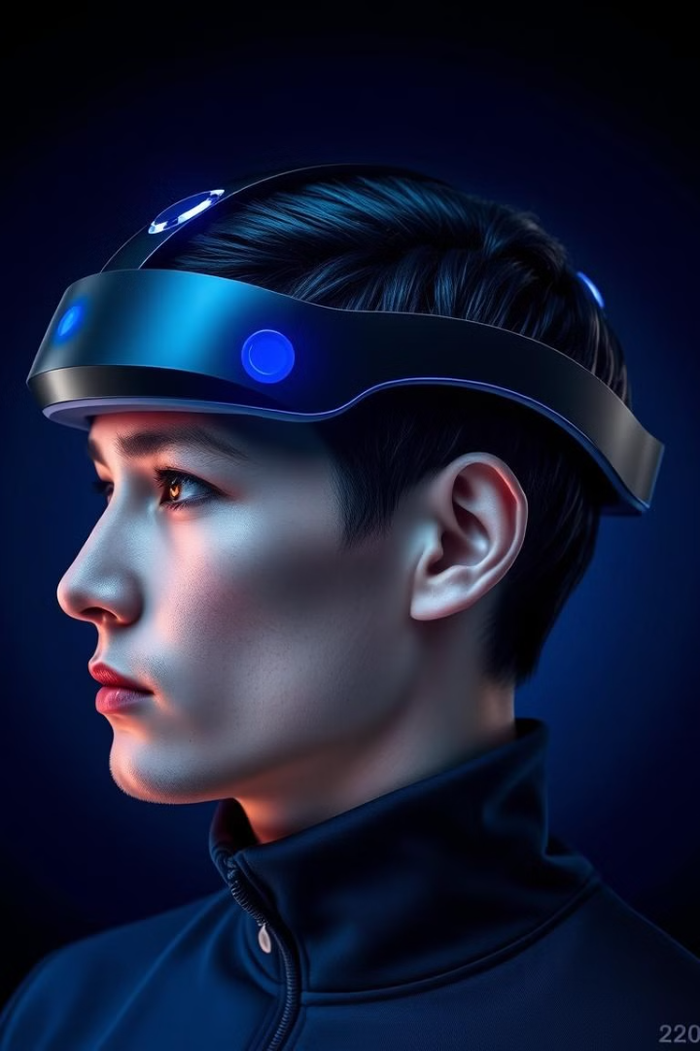
Wearable EEG Devices and Neuromorphic Chips: Integrating the Technologies
EEG devices capture brain signals with high precision, providing data for the neuromorphic chip.
The data is transmitted wirelessly to the chip, which analyzes the signals in real-time.
The neuromorphic chip processes the data, identifying seizure patterns and generating alerts.

Slide 13

Transforming Epilepsy Care: Benefits of Neuromorphic Computing
Real-Time Monitoring
Early Intervention
Enables continuous seizure detection, providing a proactive approach to management.
Alerts healthcare providers and patients in real-time, enabling prompt intervention and reducing seizure severity.
Improved Patient Outcomes
Reduces seizure frequency and duration, enhancing patient quality of life and independence.

Slide 14
Challenges in Adopting Neuromorphic Computing for Epilepsy
Data Privacy and Security
1
Ensuring the secure storage and ethical use of sensitive patient data is crucial.
Regulatory Approval
2
Obtaining approval from regulatory bodies for new medical technologies is essential.
Cost and Accessibility
3
Making neuromorphic computing solutions affordable and accessible to all patients is a priority.

Slide 15




Future Scope: Expanding Neuromorphic Computing in Healthcare
Personalized Medicine
Developing tailored treatments and therapies based on individual brain activity and responses.
Cardiovascular Disease
Monitoring heart rhythms and detecting anomalies for early intervention and prevention.
Prosthetics and Robotics
Creating advanced prosthetics and robotic systems that respond to neural signals and improve functionality.

Slide 16
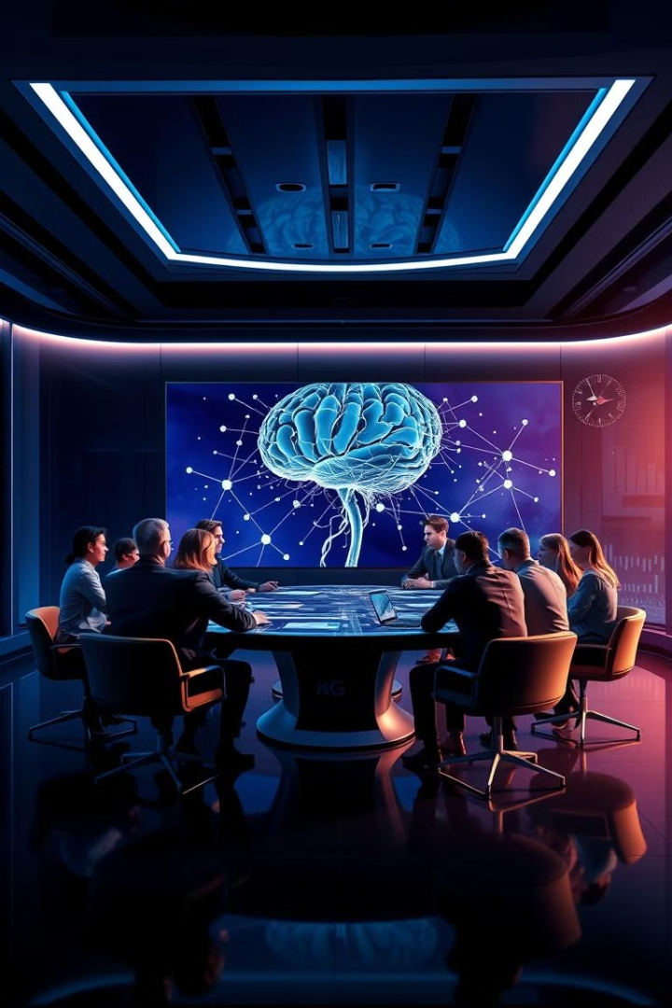
Conclusion and Q&A Session
Neuromorphic computing has the potential to revolutionize epilepsy management by providing real-time seizure detection, improving patient outcomes, and facilitating personalized treatment. The future holds great promise for this technology's impact on healthcare.

Slide 17
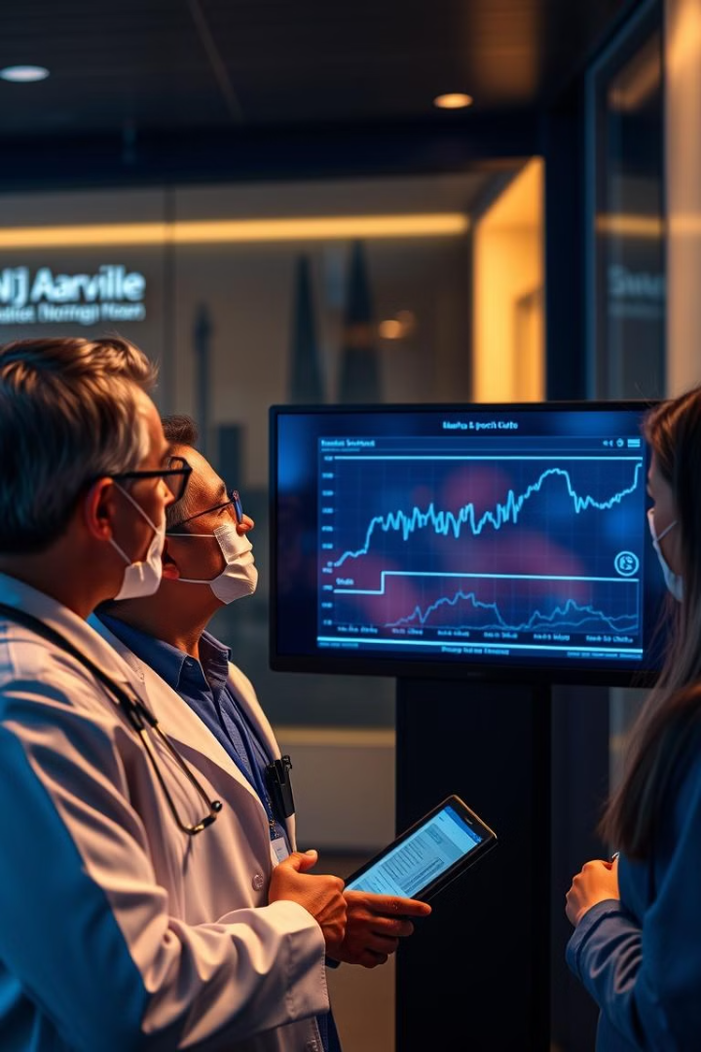
THANK YOU

